Slide 1
Observing Occultations
Using Video:
A Beginner’s Guide
Jacquie Milner
20th April 2014
TTSO8
NACAA XXVI
Notes:
Hello. Today I would like to introduce you to a manual that has been in development over the last four years which aims to get more people into observing occultations.

Slide 2
What is an Occultation?
Occultation: When one celestial body passes in front of another celestial body, hiding that body from view.
Eclipse: When the occulting body is similar in size to the hidden body.
Transit: When the occulting body is much smaller than the hidden body.
Notes:
To occult something is to hide it. In astronomy there are several situations where occultations occur, although you might know them by different names. So for this presentation we will be referring to an occultation as where one body covers and hides another. An eclipse is a kind of occultation, where the two bodies involved are about the same size, and a transit is where the occulting body is much smaller than the ‘hidden’ body, which isn’t really hidden.

Slide 3
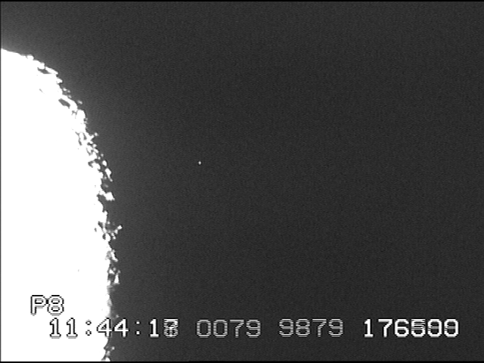
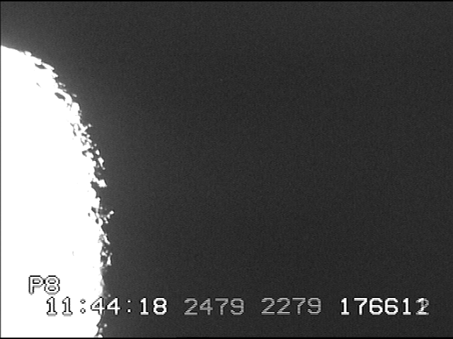
The different types observed:
Total lunar occultation (double stars)
Grazing occultation
Notes:
There are two main areas of focus for occultations and they are lunar occultations and minor planet or asteroid occultations (the term tends to be interchangeable). Major planets do occasionally occult stars, or are occulted by the Moon, but they are rare and there is not a great deal to be learnt from them today. However there is still information to be gained from Lunar occultations; not for tracking the orbit of the Moon, which occultations were once very important for, but for confirming the profile of the lunar limb at the time and also in the discovery of previously known double stars and determining the position angle of the secondary star in a known double, especially if they are very close. Grazing occultations are also still pursued. They can involve a team of people heading out together and many an adventure has been had along the way with these types of events, but you can still observe a graze by yourself at home. This slide demonstrates a star being occulted by the dark limb of the waxing Moon.

Slide 4
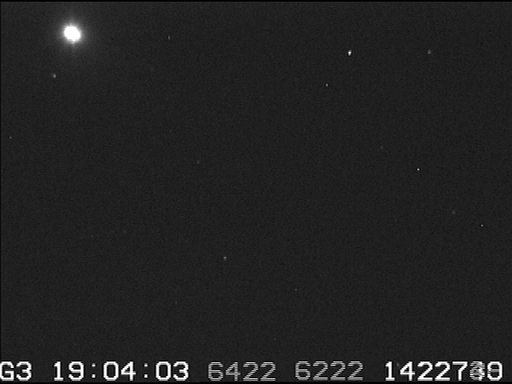
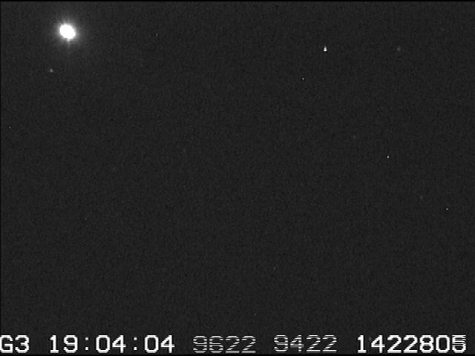



The different types observed:
Minor planet or asteroid occultations
Notes:
A minor planet or asteroid occultation is when an asteroid passes in front of a star and the length of time the star is occulted is noted. This animated slide gives a brief demonstration of this kind of event.

Slide 5
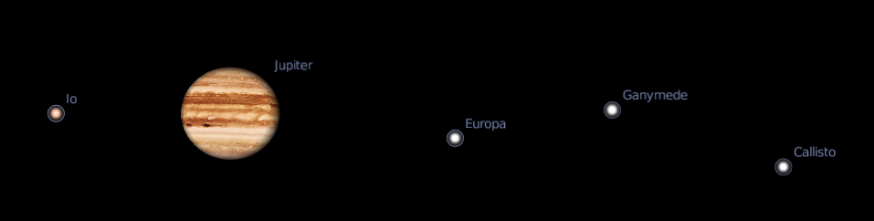
The different types observed:
Solar eclipses – Baily’s Beads
Jovian satellites mutual events
Notes:
Observing Baily’s Beads during a solar eclipse is still useful information and when the alignment is the right the Galilean satellites orbiting Jupiter may be seen eclipsing and transiting one another.

Slide 6
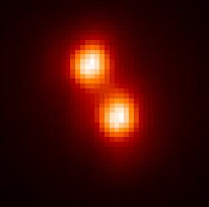
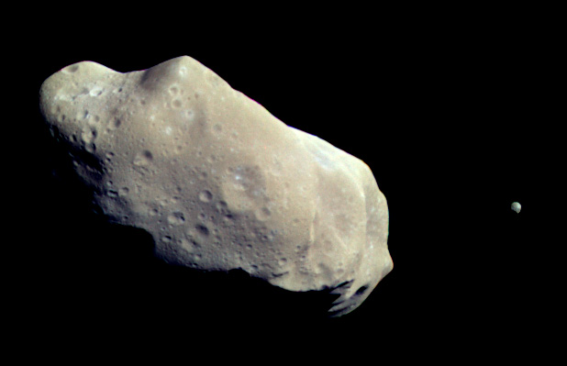
Why observe occultations?
To get information that we can’t get by other means of observation,
Credit: M. Merline (SwRI), et al
short of sending a spacecraft to get up close and personal with it.
Credit: NASA/JPL
Notes:
To get information that we can’t get by other means of observation, short of sending a spacecraft to get up and close and personal with it. On the left we have the binary asteroid (90) Antiope taken by the Keck Telescope. The two components are still just blobs. On the right we have the asteroid (243) Ida, taken by the Galileo probe on its way to Jupiter. Let’s have a quick look at some of information that can be determined by observing occultations.

Slide 7
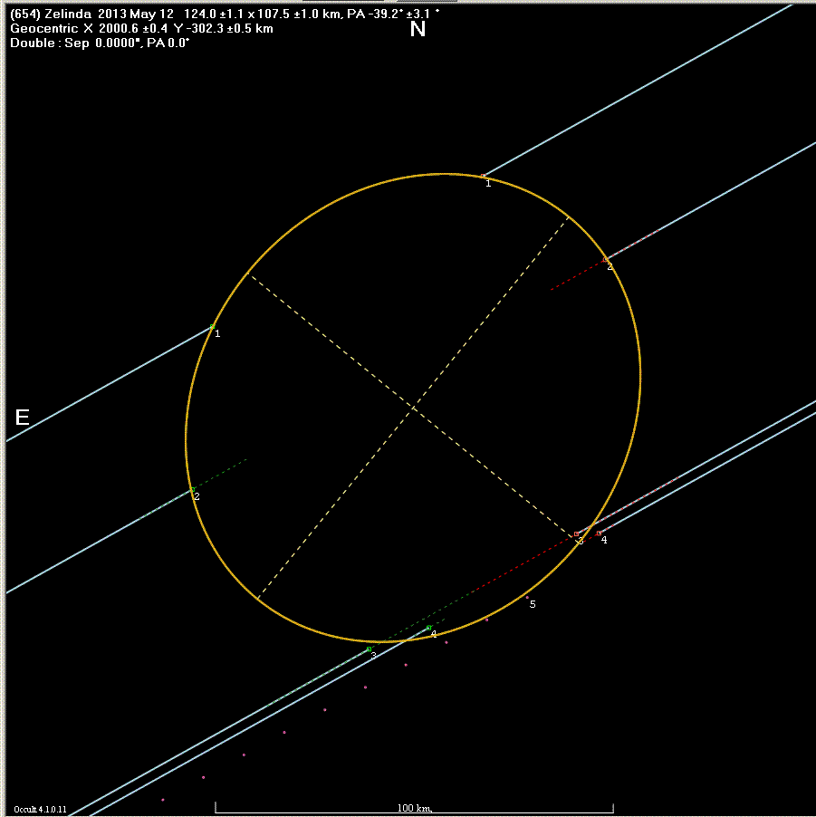
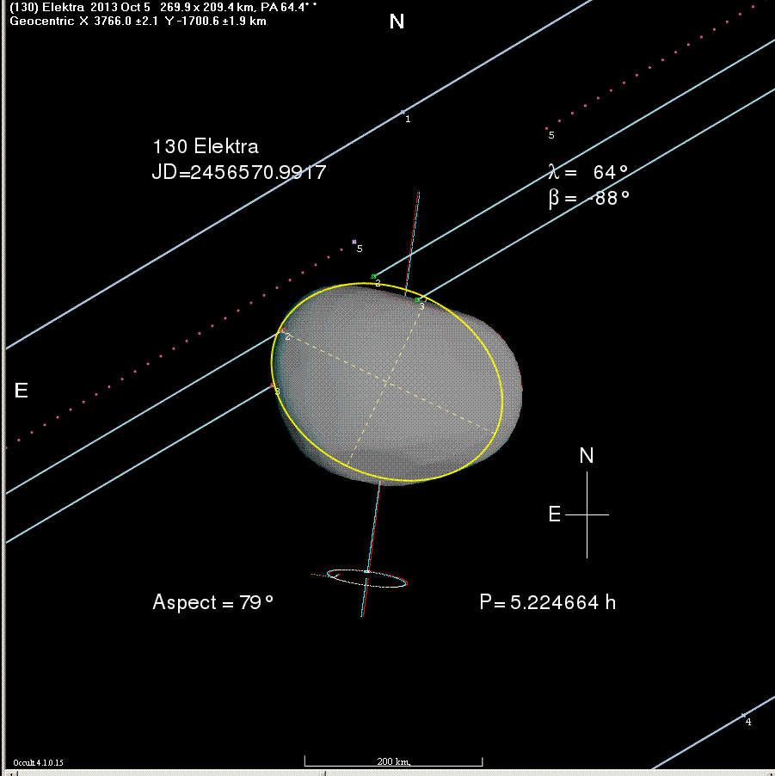
The size of the minor planet
Notes:
This is the obvious one but still a very useful one. Asteroid size is often estimated on its albedo value i.e. the brighter it is the bigger it must be. But this isn’t always the case; if the body is quite dark you can get a false estimate. There are also a number of 3D models available now that have been created from photometric measurements as the asteroids slowly rotate and if one these modelled asteroids is occulted we can try and fit the asteroid to a angle of orientation. If two or more chords are observed and a good fit to the shape of the asteroid can be gained, in both cases, helps us improve the orbit of the asteroid as well.

Slide 8
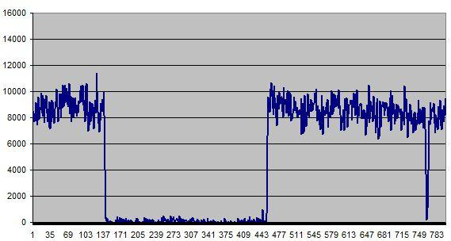
Detection of asteroid satellites
Main body
satellite
(911) Agamemnon on 19 January 2012
Notes:
We now know that many asteroids have satellites or are part of a binary system. Discovery may be made by observing an occultation, such as in this example a couple of years ago.

Slide 9
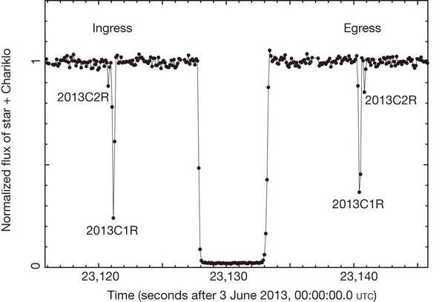
Detection of ring systems
Rings detected around Centaur 10199 Chariklo
Credit: F. Braga-Ribas et al
Notes:
We’ve just had this stunning example of icy rings around the Centaur (10199) Chariklo announced about a month ago. More could be out there! And of course the rings of Uranus were discovered by an occultation in 1977.

Slide 10
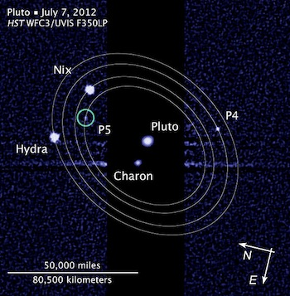
Observing Pluto & other TNO’s
Notes:
With New Horizons speeding out towards Pluto there has been an emphasis on trying to observe Pluto occulting stars in recent years, both to refine it’s orbit and observe the state of it’s atmosphere. The discovery of more moons than just Charon is not quite an accident – occultation results showed that there were other bodies out there tugging Pluto around.
In addition to what I’ve already mentioned, occultations can also help to refine the position of the star that it is occulting and has the potential to determine stellar diameters for larger stars.

Slide 11
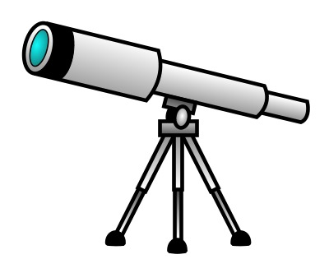
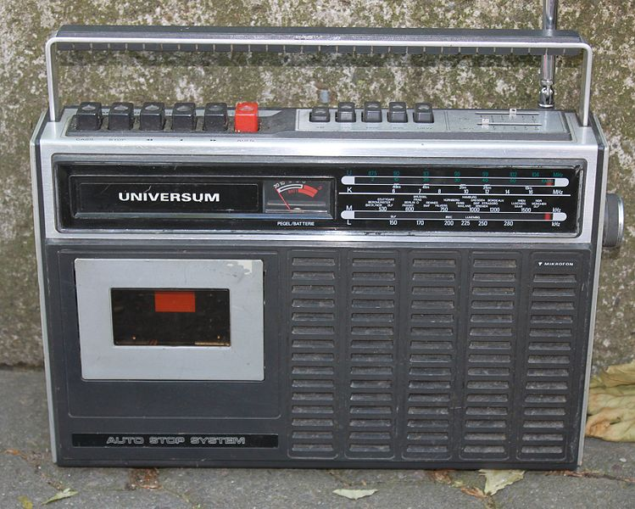
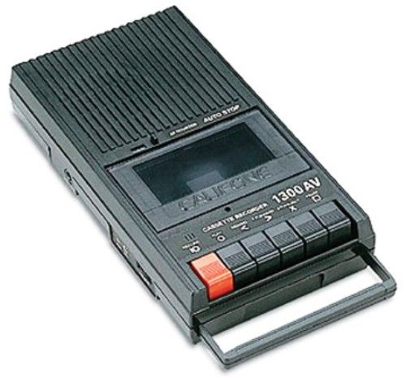
In the “old” days…
Gone!
Back!
bip
bip
BEEP!
Notes:
So, how can you get involved? Originally it was pretty simple. You got a shortwave radio and tuned it in the VNG time signals. Then you may found an extra tape recorder or voice recorder if your radio didn’t have that facility. You sat down with your telescope at the ready, time signals beeping away in the background and made some noise as the star blinked off and/or on. You then listened to your tape later and estimated to the nearest 10th of a second as to what the time was.

Slide 12
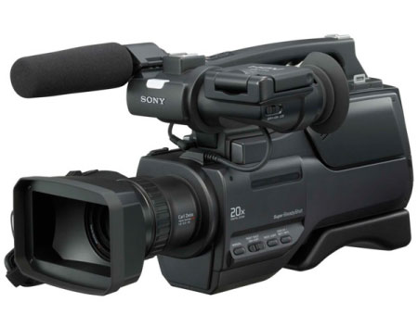
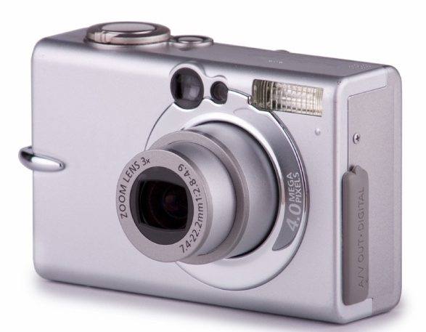
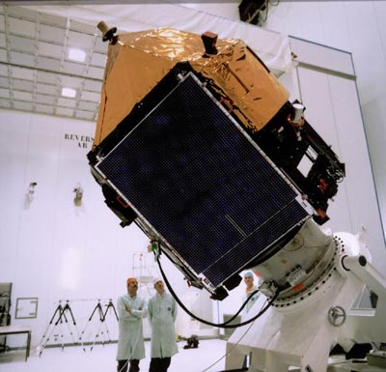
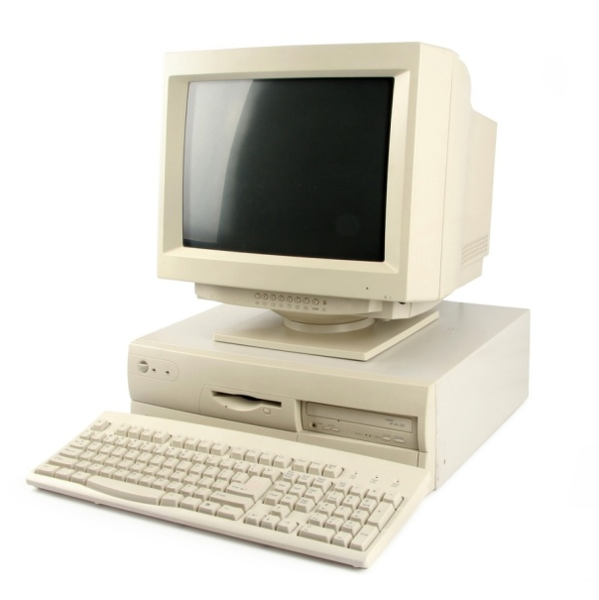
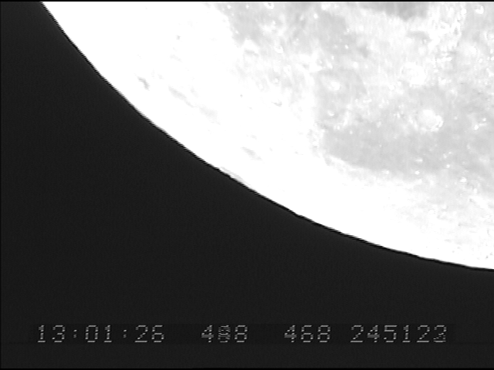
…then things starting changing…
Notes:
12. Then things started changing…
Computers began to get bigger and faster – this helped with more predictions being available.
The Hipparcos satellite was sent up and mapped the nearby stars far more accurately than before.
Video cameras kept improving
The digital photography revolution came along
The VNG time signals were discontinued in the Australian region
Video Time Insertion (VTI) units using GPS time signals started to appear

Slide 13
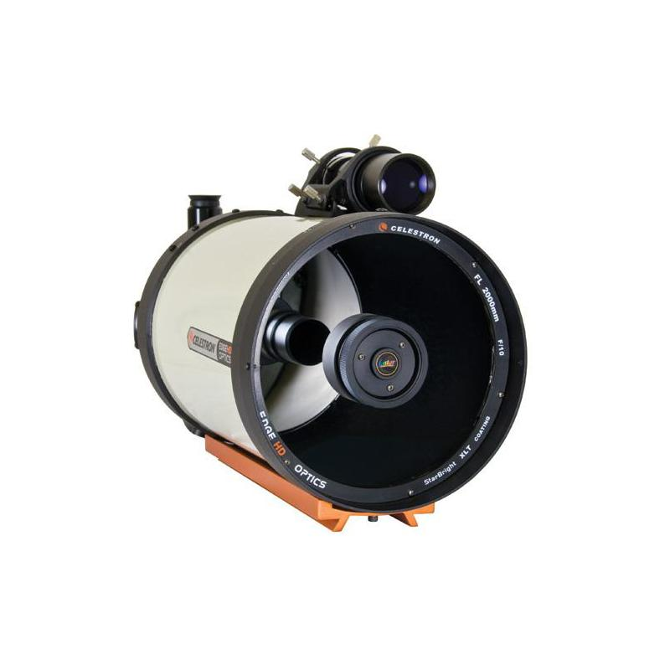
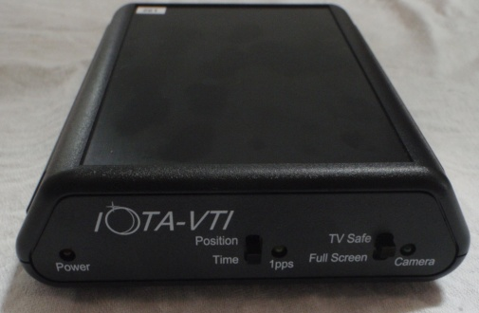
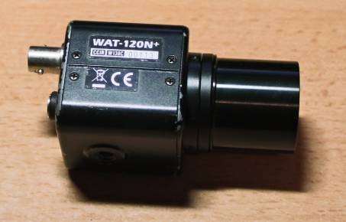

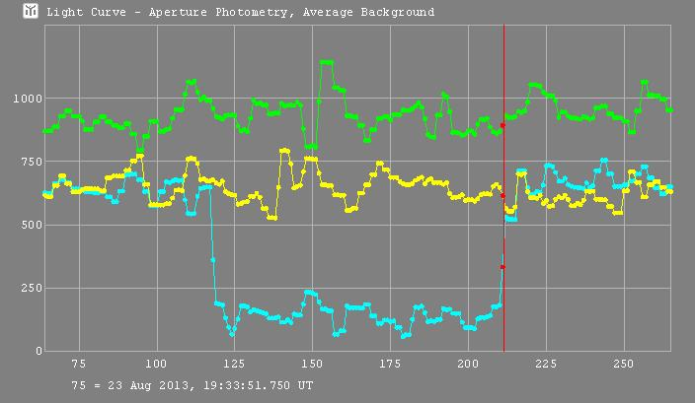
… to reach the current set up.
Notes:
Today occultation observing is largely a digital affair. Telescopes haven’t changed much, but you can now get a reliable VTI unit (designed by Australians, by the way), low-light video cameras that can detect a 1000th of a lux as well as integrate the frames to help detect faint stars and fast, cheap computers with loads of disk space, vital when a minute of uncompressed video takes over 1 GB of space on the hard drive. We shouldn’t forget the software developments as well – this is an example of a light curve output from analysing a video through Tangra, also an Australian product.

Slide 14
Where to start?
Notes:
In the rapidly changing world of astro-imaging, particularly in the last decade or so, there have been a lot of changes, and if you haven’t been keeping up, or aren’t that technologically minded, the move to video observation of occultations can be a bit daunting.

Slide 15
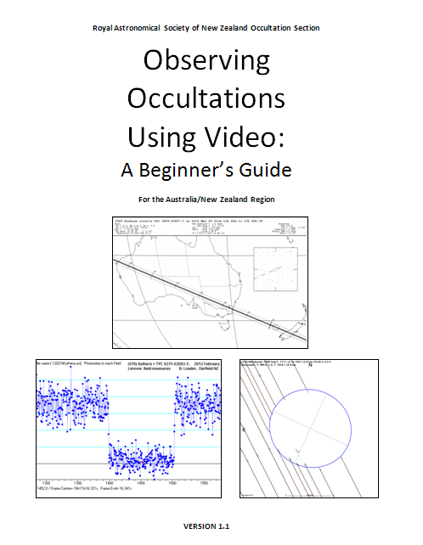
Notes:
Help is now at hand! Launched at TTSO7 in Invercargill last year (2013) you can now download a free copy of the manual: Observing Occultations Using Video: A Beginner’s Guide. This comprehensive document can guide you from start to end in preparing for and observing an occultation, lunar or minor planet, and reducing and reports afterwards.

Slide 16
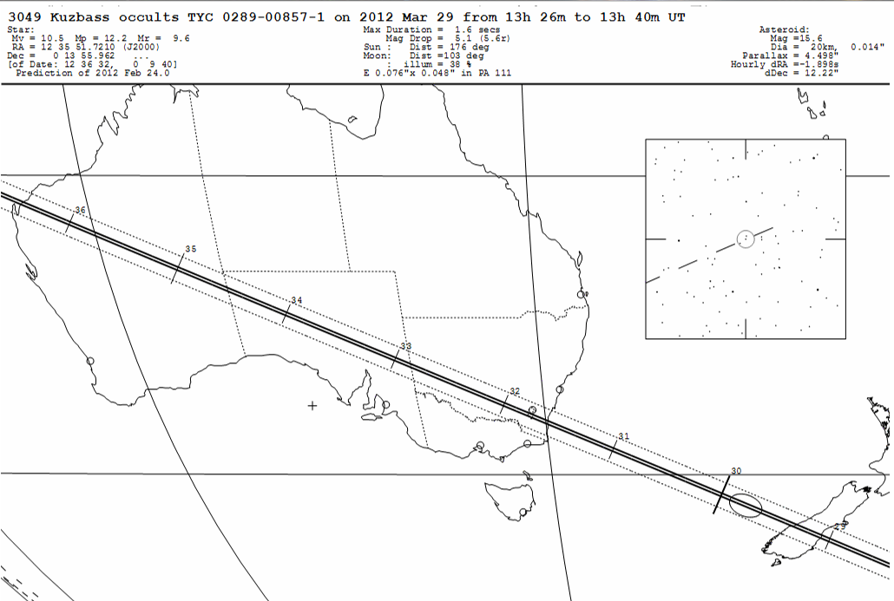
Understanding predictions
Notes:
The main sections are as follows: A chapter on understanding predictions, including where and when to observe and why its often worth observing regardless of the indication that you’re unlikely to see anything. As many predictions still retain a large degree of uncertainty about them you never know what you’re going to get - many an observer has reported a hit when the prediction indicated a miss! And constraining misses are very important too, when you would like to know which side of the predicted line the asteroid has shifted to.

Slide 17
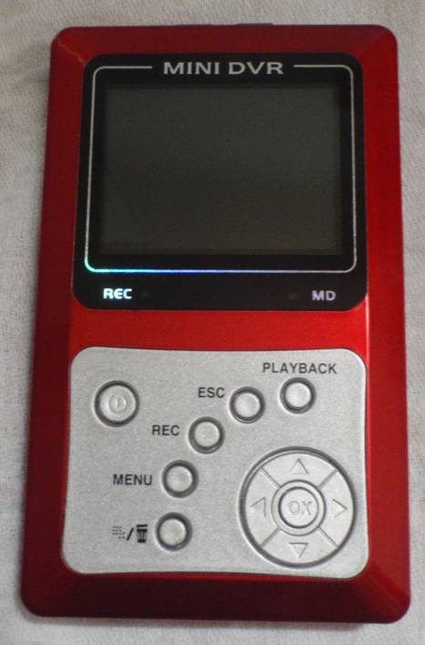
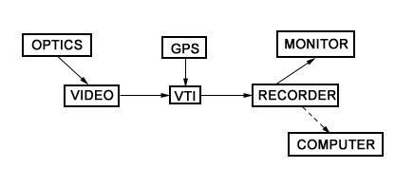
What equipment you need
Notes:
There are two chapters discussing the equipment you need to get a video system going. The basic components are shown here: a telescope of some sort (any kind!) an astronomical video camera, preferably with a capacity to integrate frames, a GPS and video time insertion unit (they usually come together), and a recording unit. Computers can fill this role, in which case the last three components are all rolled into one.

Slide 18
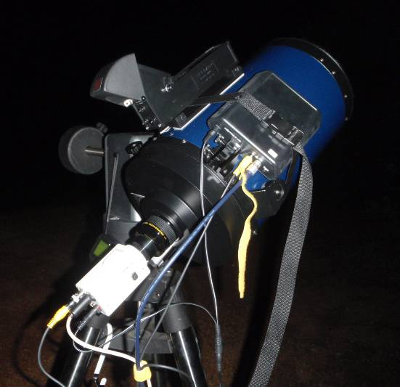
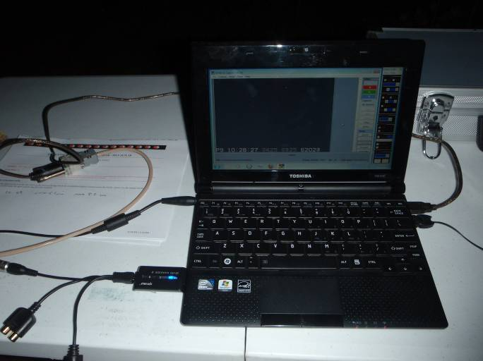
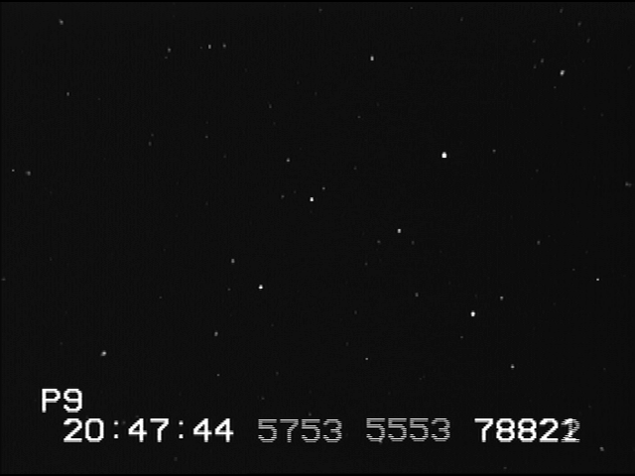
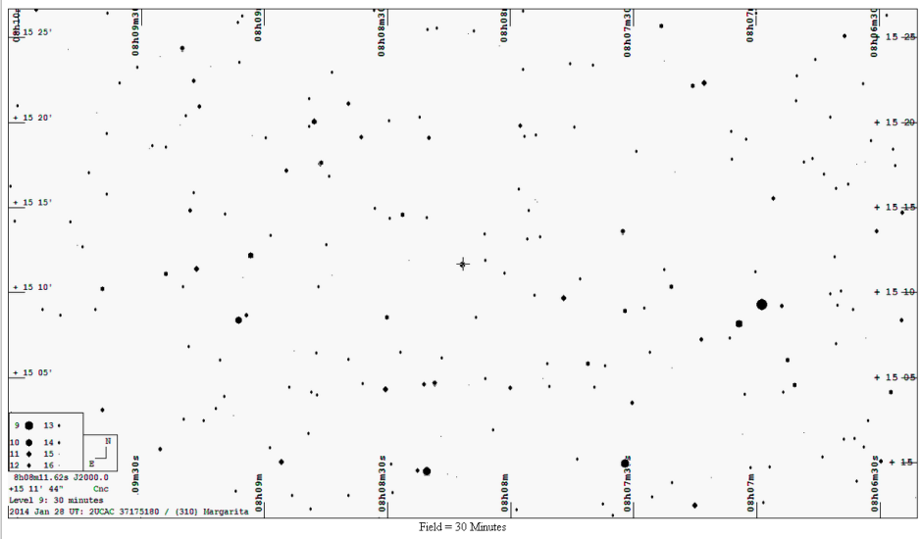
Getting it all together in the field
Notes:
There is a discussion and some hints for success once you try to put it all together under the stars.

Slide 19
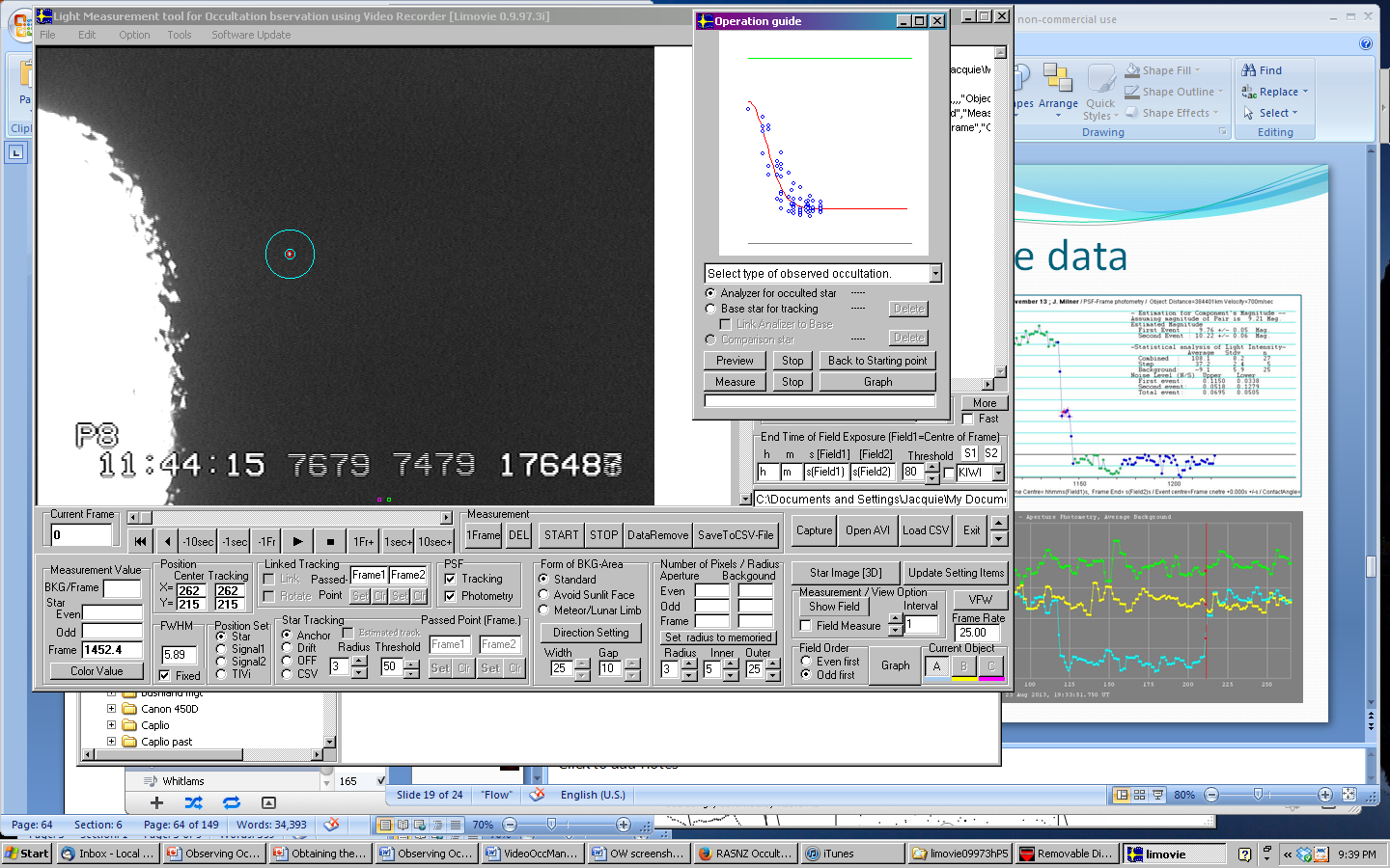
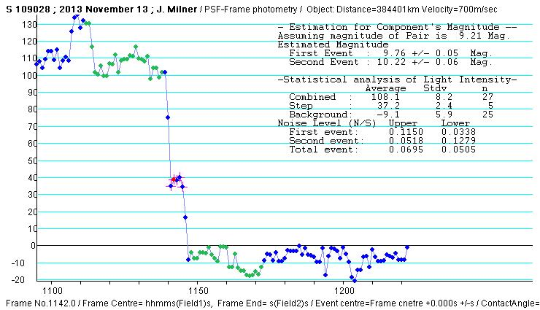
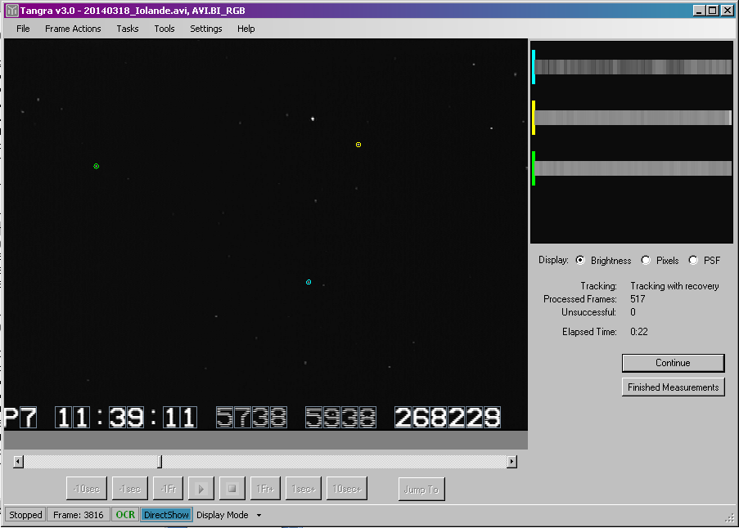
Reducing the data
LiMovie
Tangra
Notes:
Once you have captured your video you need to analyse the data and extract the times (as the bottom line is all about getting the right time, after all). The manual has some help to guide you through the use of LiMovie, a Japanese-made program for analysing lunar occultations, and mentions Tangra as well, where creator Hristo Pavlov has written some good guides for the use of that program. The final output for both programs is a comparative light curve from which you can find out which the right frame to note from the time from.

Slide 20
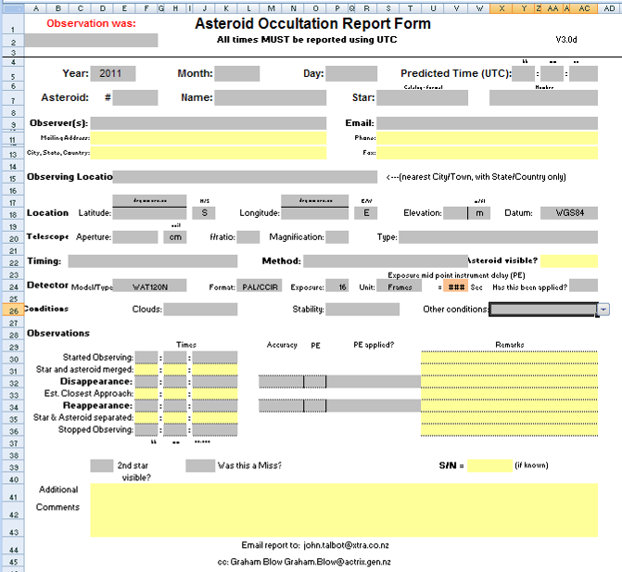
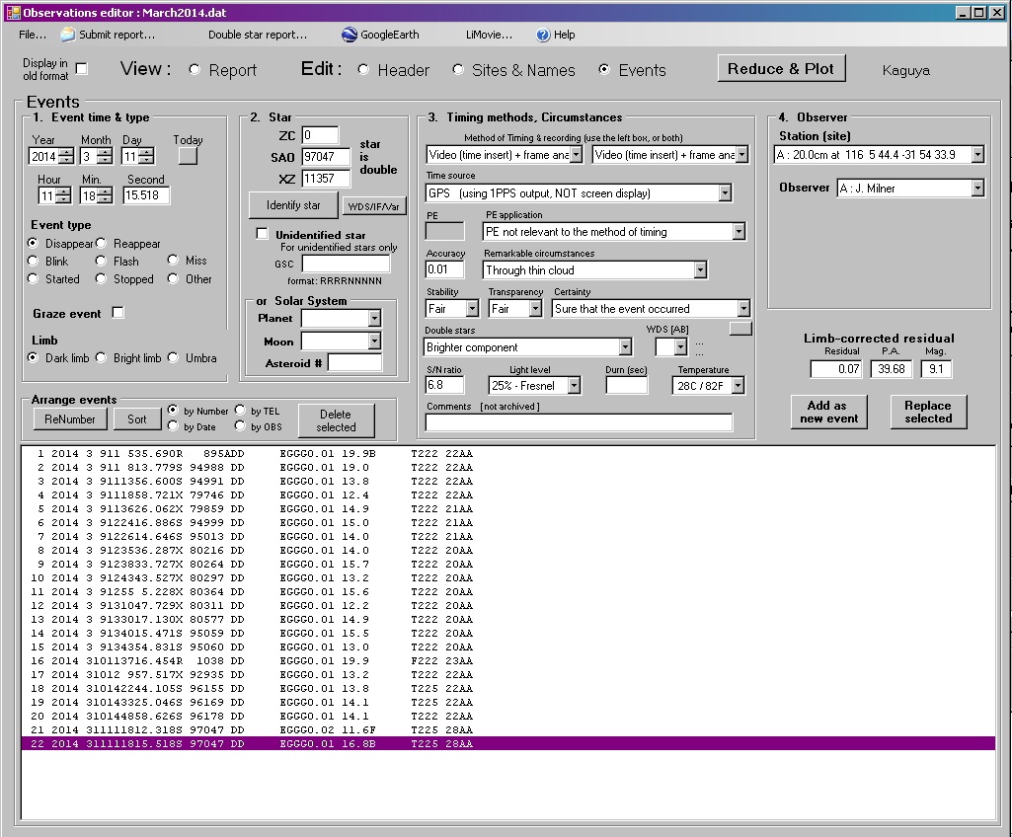
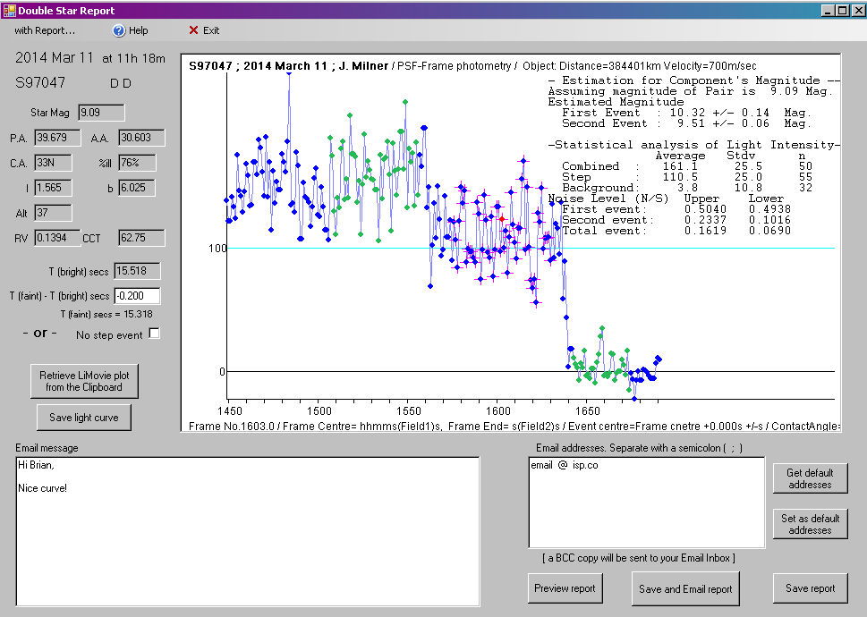
Making a report
Notes:
Once you have the timing of the event it is time to make a report. The manual guides you through the three main report forms used in our region, for minor planets, lunar occultations and double star reports, which are additional to the lunar report.

Slide 21
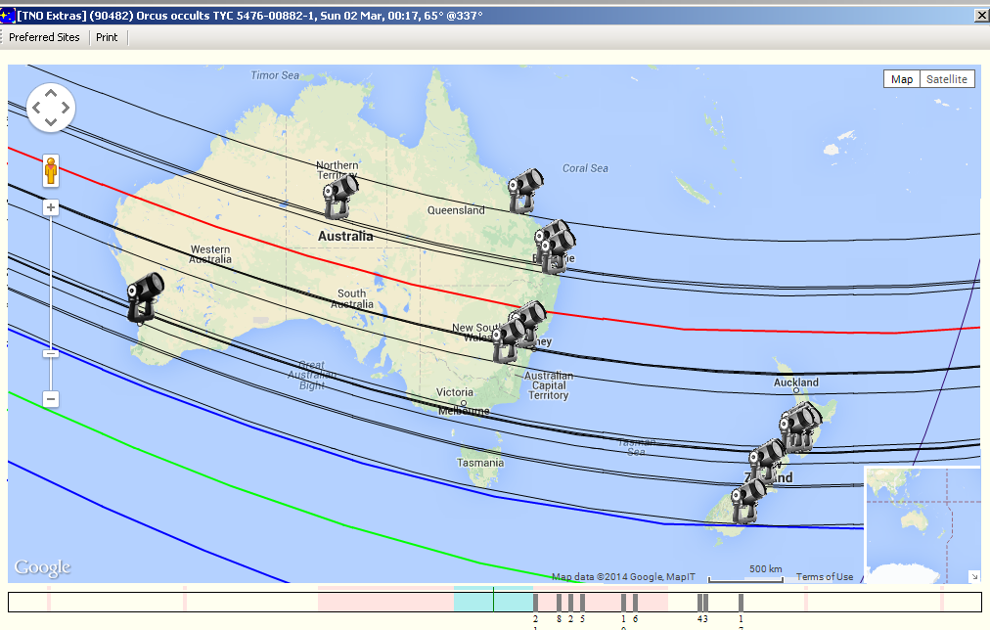
Filling the gaps in the “picket fence”
Notes:
The American observers like to use a picket fence analogy to describe getting a good spread of observers across a predicted path. It’s not practical to have a solid line but with a bit planning using OccultWatcher (where this output comes from) you can get an even spread, or an idea of where the gaps are. In this example we can see the spread of observers across Australia and New Zealand who indicated they would attempt observing an occultation by the TNO (90482) Orcus on the morning of the 2nd of March 2014. 21 stations were registered, although not all are displayed here, you can certainly get an idea of where the active observers are at the moment – and where they aren’t.

Slide 22
Remember this?
Notes:
(90) Anitope, the binary asteroid as imaged by the Keck telescope, one of the biggest in the world.

Slide 23
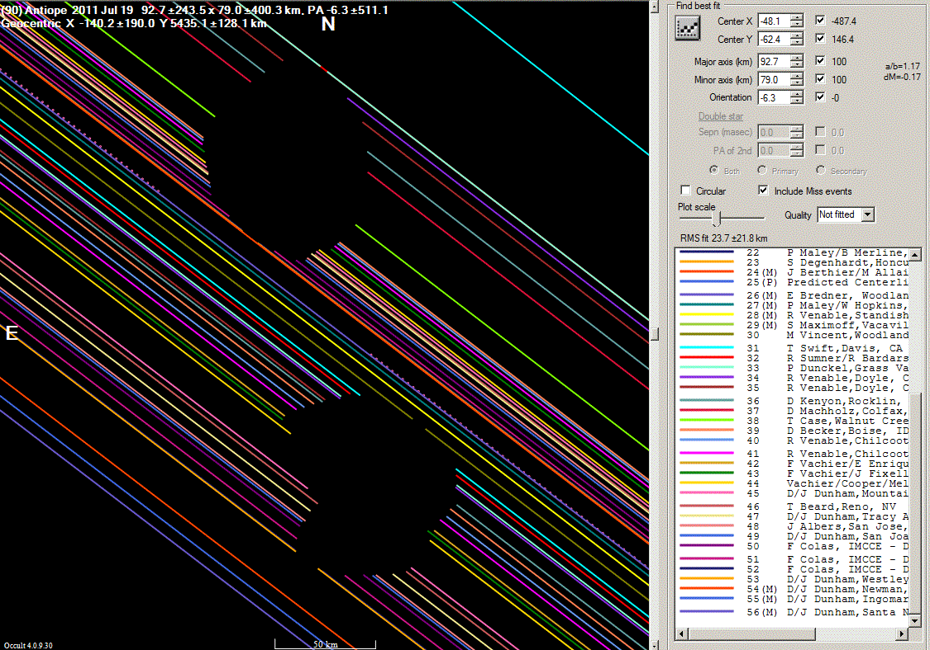
It could be this!
Notes:
This is result you can achieve when you get multiple observers on the ground. While some were unattended stations, with 54 chords going in to compile the picture here you can appreciate the level of detail that can be achieved by combining all those observations made by amateurs, compared to the rounded blobs of light that the Keck telescope produced.
It would be great to get a few more active observers in Australia, especially in those rather obvious gaps in South Australia, Victoria and Tasmania.

Slide 24
Questions?
RASNZ Occultation Section
www.occultations.org.nz/
Manual direct link:
www.occultations.org.nz/videotime/manual.htm
Notes:
The manual can be downloaded in pdf form from the link on the slide, and while you’re there check out the rest of the RASNZ occultation website and maybe even join the section.

